Slide 1

SCHOOL of COMPUTING DRPARTMENT of COMPUTER SCIENCE & ENGINEERING
COURSE CATEGORY :PROGRAM CORE
COURSE NAME:DATA WAREHOUSING AND DATA MINING
COURSE CODE:1151CS114
FACULTY: Dr. CARMEL MARY BELINDA M J

Slide 2
Course Outcomes
CO Nos. | Course Outcomes | K Level
CO1 | Explain and identify the subject areas for which a data warehouse is to be built. | K2
CO2 | Design Multidimensional data model for data warehouse and analyze the market needs by applying the suitable OLAP operations. | K3
CO3 | Explain the concept of Data mining system and apply the various preprocessing techniques on large dataset. | K2
CO4 | Apply Association rule mining, classification and clustering techniques to discover various mining patterns. | K3
CO5 | Apply clustering techniques in various data mining applications | K3

Slide 3
UNIT II TOPICS
TOPICS COVERED
Mapping the Data Warehouse to a Multiprocessor Architecture
DBMS Schemas for Decision Support
Data Extraction, Cleanup, and Transformation Tools
Reporting and Query tools and Applications
Online Analytical Processing (OLAP)
Need of Multidimensional Data Model
OLAP Guidelines
Multidimensional versus Multi relational OLAP
Categorization of OLAP Tools.

Slide 4
Mapping the Data Warehouse to a Multiprocessor Architecture
Relational data base technology for data warehouse
Linear Speed up: refers the ability to increase the number of processor to reduce response time
Linear Scale up: refers the ability to provide same performance on the same requests as the database size increases

Slide 5
Types of parallelism
Inter query Parallelism: In which different server threads or processes handle multiple requests at the same time
Intra query Parallelism: This form of parallelism decomposes the serial SQL query into lower level operations such as scan, join, sort etc. Then these lower level operations are executed concurrently in parallel.

Slide 6
Types of Intra Query Parallelism
Horizontal parallelism: which means that the data base is partitioned across multiple disks and parallel processing occurs within a specific task that is performed concurrently on different processors against different set of data.
Vertical parallelism: All query components such as scan, join, sort etc are executed in parallel in a pipelined fashion. In other words, an output from one task becomes an input into another task.

Slide 7
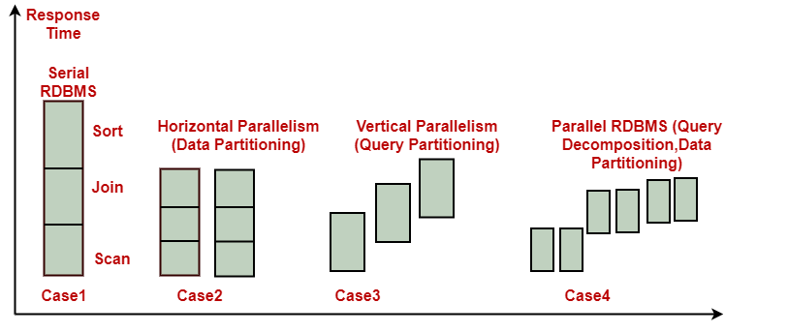
Types of Parallelism

Slide 8

Data partitioning
Data partitioning is the key component for effective parallel execution of data base operations.
Types of Data partitioning
Random portioning
Intelligent partitioning

Slide 9
Types of Data partitioning
Random portioning: Includes random data striping across multiple disks on a single server.
Intelligent partitioning: DBMS knows where a specific record is located and does not waste time searching for it across all disks.
Types of Intelligent partitioning
Hash partitioning
Key range partitioning
Schema portioning
User defined portioning

Slide 10
Types of Intelligent partitioning
Hash partitioning: A hash algorithm is used to calculate the partition number based on the value of the partitioning key for each row.
Key range partitioning: Rows are placed and located in the partitions according to the value of the partitioning key. That is all the rows with the key value from A to K are in partition 1, L to T are in partition 2 and so on.
Schema portioning: an entire table is placed on one disk; another table is placed on different disk etc. This is useful for small reference tables.
User defined portioning: It allows a table to be partitioned on the basis of a user defined expression.

Slide 11
Data base architectures of parallel processing
Shared memory or shared everything Architecture
Shared disk architecture
Shred nothing architecture
parallel database architecture
Shared memory architecture
Shared disk architecture
Shred nothing architecture

Slide 12
Shared Memory Architecture
Multiple PUs share memory.
Each PU has full access to all shared memory through a common bus.
Communication between nodes occurs via shared memory.
Performance is limited by the bandwidth of the memory bus
Scalability is limited by bus bandwidth and latency, and by available memory.

Slide 13
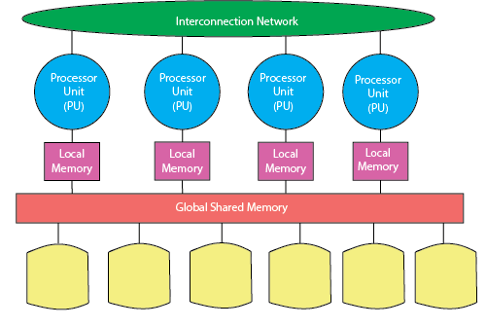
Shared Memory Architecture

Slide 14
Shared disk architecture
Each node consists of one or more PUs and associated memory.
Memory is not shared between nodes.
Communication occurs over a common high-speed bus.
Each node has access to the same disks and other resources.
A node can be an SMP if the hardware supports it.

Slide 15
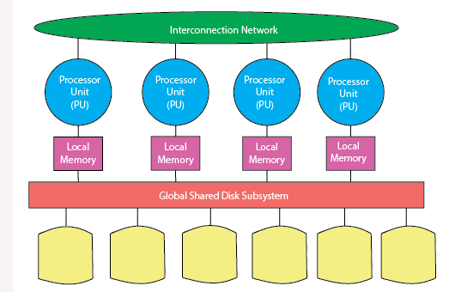
Shared disk architecture

Slide 16
Shared nothing architecture
Shared nothing systems are typically loosely coupled.
In shared nothing systems only one CPU is connected to a given disk. If a table or database is located on that disk.
Shared nothing systems are concerned with access to disks, not access to memory.
Adding more PUs and disks can improve scale up.

Slide 17
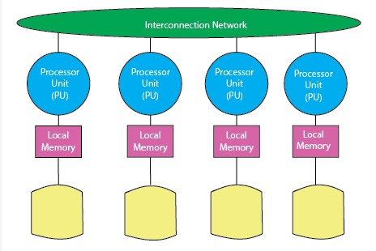
Shared nothing architecture

Slide 19
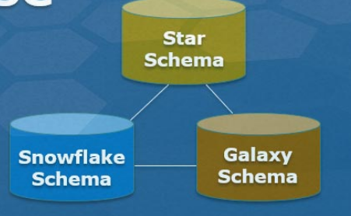
DBMS Schemas for Decision Support
Star schema
Snowflake schema
Fact constellation schema(Galaxy Schema )

Slide 20
Star Schema
A schema is a logical description that describes the entire database. In the data warehouse there includes the name and description of records.
In a star schema, there is one fact table in the middle and a number of associated dimension tables. This structure resembles a star and hence it is known as a star schema.
The primary key which is present in each dimension is related to a foreign key which is present in the fact table.

Slide 21
Characteristics of Star Schema:
Every dimension in a star schema is represented with the only one-dimension table.
The dimension table should contain the set of attributes.
The dimension table is joined to the fact table using a foreign key
The dimension table are not joined to each other
Fact table would contain key and measure
The Star schema is easy to understand and provides optimal disk usage.
The dimension tables are not normalized.

Slide 22
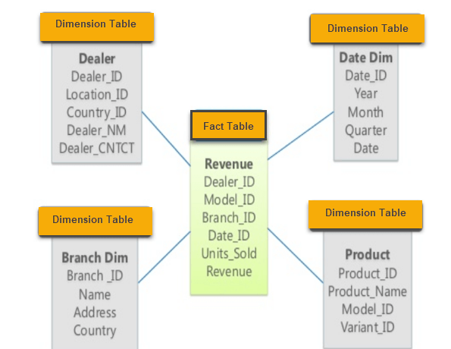
Example of Star Schema

Slide 23
Snowflake schema
Snowflake schema acts like an extended version of a star schema.
The centralized fact table will be connected to different multiple dimensions.
The dimensions present are in normalized form from the multiple related tables which are present.

Slide 24
Characteristics of Snowflake Schema:
The main benefit of the snowflake schema it uses smaller disk space.
Easier to implement a dimension is added to the Schema
Due to multiple tables query performance is reduced

Slide 25
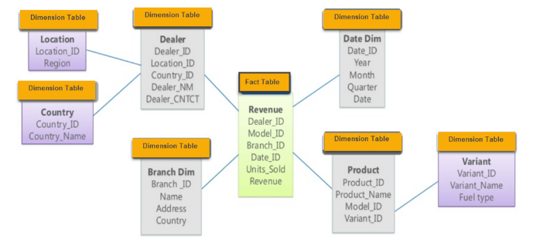
Example for Snowflake schema

Slide 26
Fact constellation schema (Galaxy Schema )
A fact constellation can consist of multiple fact tables. These are more than two tables that share the same dimension tables. This schema is also known as galaxy schema.
It is viewed as a collection of stars and hence the name galaxy. The shared dimensions in this schema are known as conformed dimensions.

Slide 27
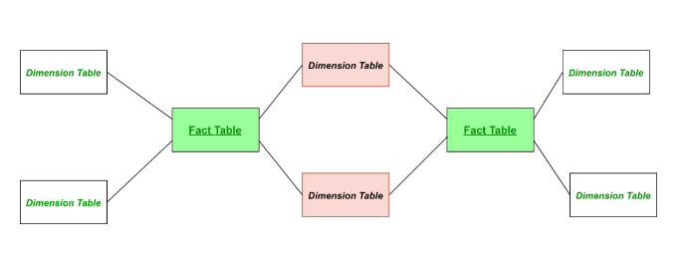
Example for Fact constellation schema (Galaxy Schema )

Slide 28
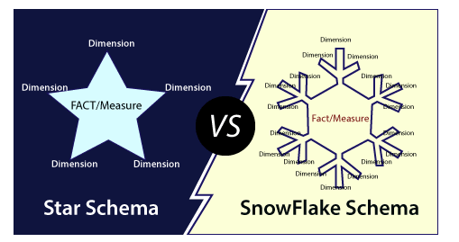
Difference between Star and Snowflake Schema.

Slide 29
Difference
Basis for Comparison | Star Schema | Snowflake Schema
Ease of Maintenance/change | It has redundant data and hence less easy to maintain/change | No redundancy and therefore more easy to maintain and change
Ease of Use | Less complex queries and simple to understand | More complex queries and therefore less easy to understand
Parent table | In a star schema, a dimension table will not have any parent table | In a snowflake schema, a dimension table will have one or more parent tables
Query Performance | Less number of foreign keys and hence lesser query execution time | More foreign keys and thus more query execution time
Normalization | It has De-normalized tables | It has normalized tables
Type of Data Warehouse | Good for data marts with simple relationships (one to one or one to many) | Good to use for data warehouse core to simplify complex relationships (many to many)
Joins | Fewer joins Higher | number of joins

Slide 30
Diff
Dimension Table | It contains only a single dimension table for each dimension | It may have more than one dimension table for each dimension
Hierarchies | Hierarchies for the dimension are stored in the dimensional table itself in a star schema | Hierarchies are broken into separate tables in a snowflake schema. These hierarchies help to drill down the information from topmost hierarchies to the lowermost hierarchies.
When to use | When the dimensional table contains less number of rows, we can go for Star schema. | When dimensional table store a huge number of rows with redundancy information and space is such an issue, we can choose snowflake schema to store space.
Data Warehouse system | Work best in any data warehouse/ data mart | Better for small data warehouse/data mart.

Slide 31
Example
Suppose that a data warehouse consists of the four dimensions, date, spectator, location, and game, and the two measures, count and charge, where charge is the fare that a spectator pays when watching a game on a given date. Spectators may be students, adults, or seniors, with each category having its own charge rate. The location dimension is further divided to City dimension table . Identify the schema and draw the diagram.

Slide 32
example
Suppose that a data warehouse for Big University consists of the following four dimensions: student, course, semester, and instructor, and two measures count and avg grade. When at the lowest conceptual level (e.g., for a given student, course, semester, and instructor combination), the avg grade measure tores the actual course grade of the student. At higher conceptual levels, avg grade stores the average grade for the given combination. Draw a star schema diagram for the data warehouse

Slide 33
Example
Consider a sales data warehouse consists two fact tables, one sales fact and other ship fact. Both fact shares the product and date dimension tables. As you can see centralized fact tables holds the primary key from the dimension tables. The sales data of a company with respect to the four dimensions, namely time, item, branch, and location.The shipping fact table has the five dimensions, namely item_key, time_key, shipper_key, from_location, To location. Construct the schema

Slide 34
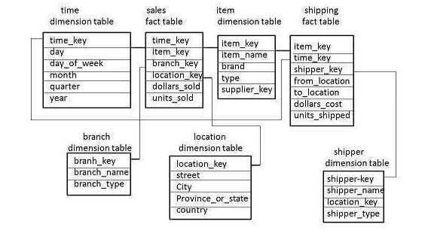

Slide 35
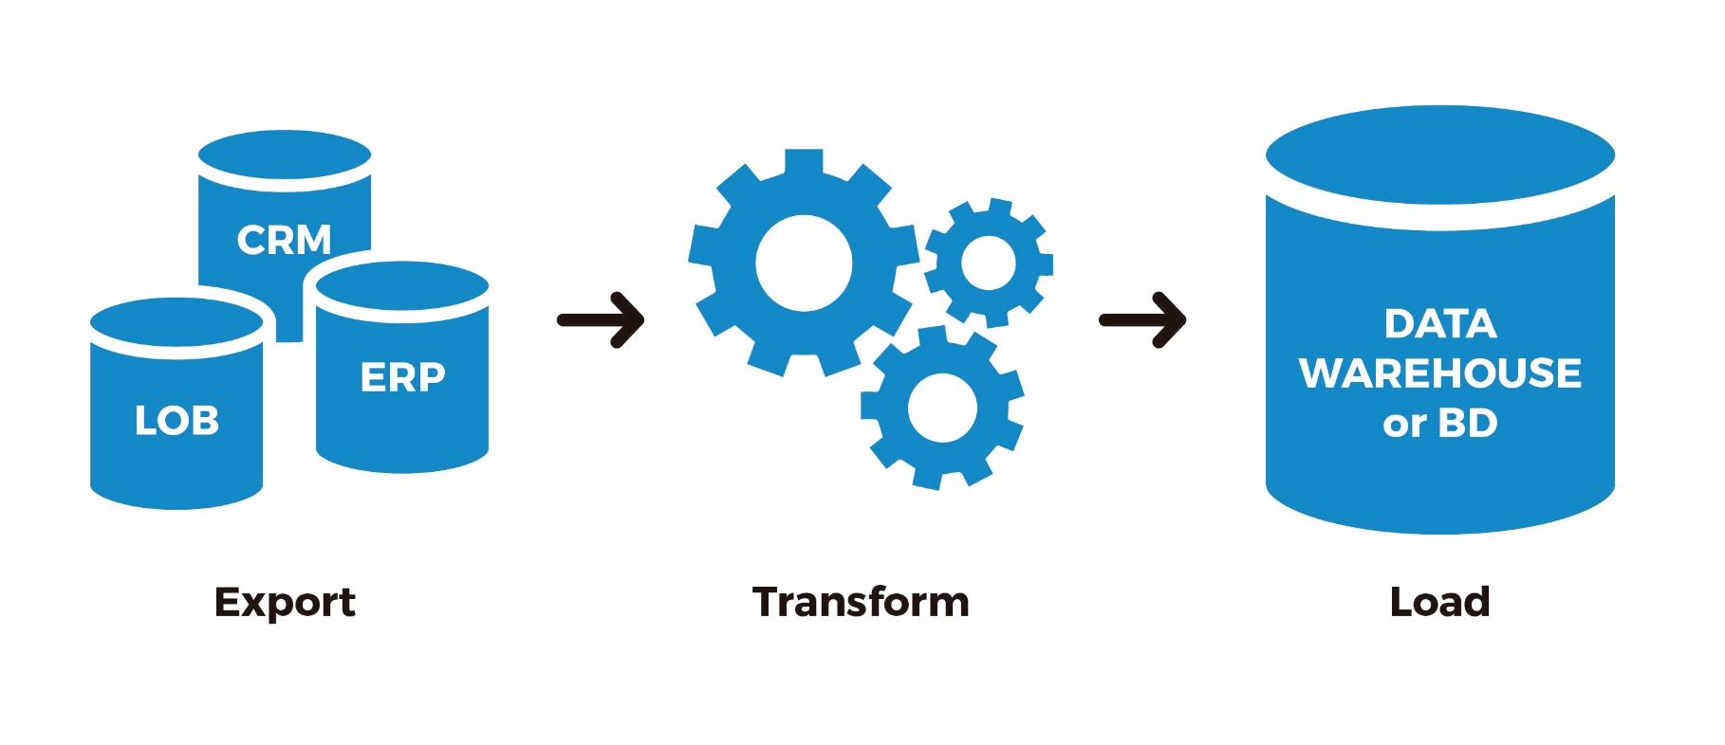
Data Extraction, Cleanup, and Transformation Tools

Slide 36
Data Extraction, Cleanup, and Transformation Tools
Data extraction is a process that involves retrieval of data from various sources.
Frequently, companies extract data in order to process it further,
migrate the data to a data repository
(such as a data warehouse or a data lake) or to further analyze it.
It's common to transform the data as a part of this process.

Slide 37
Data Extraction, Cleanup, and Transformation Tools
Data cleansing or data cleaning is the process of detecting and correcting (or removing) corrupt or inaccurate records from a record set, table, or database and refers to identifying incomplete, incorrect, inaccurate or irrelevant parts of the data and then replacing, modifying, or deleting the dirty or coarse data.

Slide 38
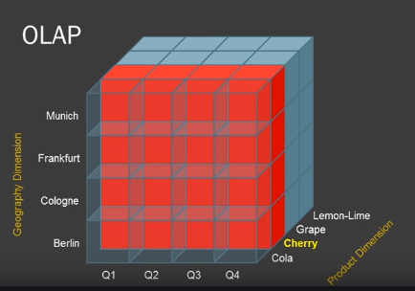
OLAP
Online Analytical Processing Server (OLAP) is based on the multidimensional data model.
It allows managers, and analysts to get an insight of the information through fast, consistent, and interactive access to information.

Slide 39
Basic analytical operations of OLAP
Four types of analytical operations in OLAP are:
Roll-up
Drill-down
Slice and dice
Pivot (rotate)

Slide 40
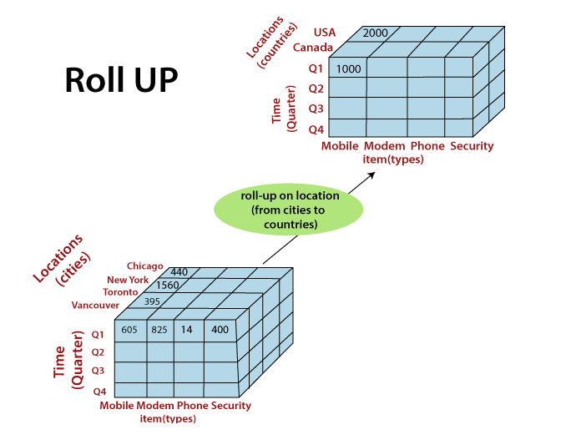
Roll-Up
The roll-up operation (also known as drill-up or aggregation operation) performs aggregation on a data cube, by climbing down concept hierarchies

Slide 41
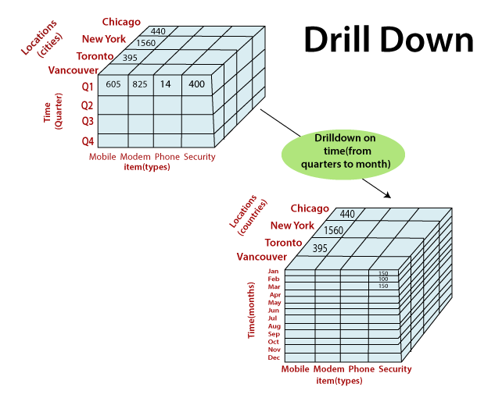
Drill-Down
The drill-down operation (also called roll-down) is the reverse operation of roll-up.
Drill-down can be performed by either stepping down a concept hierarchy for a dimension or adding additional dimensions.

Slide 42
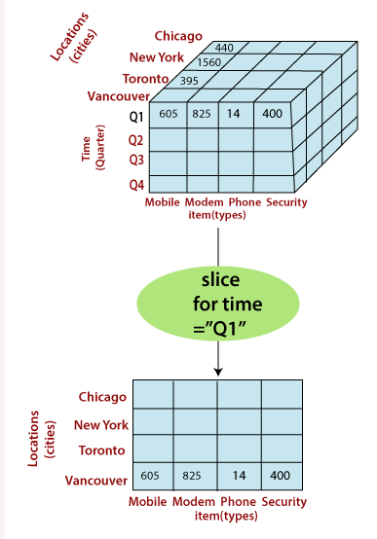
Slice
A slice is a subset of the cubes corresponding to a single value for one or more members of the dimension.
the Slice operations perform a selection on one dimension of the given cube, thus resulting in a subcube.

Slide 43
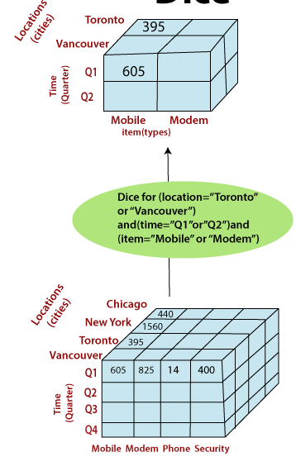
Dice
The dice operation describes a sub cube by operating a selection on two or more

Slide 44
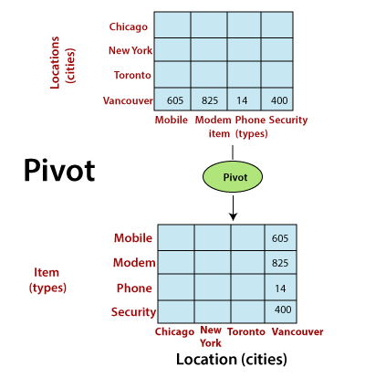
Pivot
The pivot operation is also called a rotation.
Pivot is a visualization operations which rotates the data axes in view to provide an alternative presentation of the data.

Slide 45
Who uses OLAP and Why?
Finance and accounting:
Budgeting
Activity-based costing
Financial performance analysis
And financial modeling
Sales and Marketing
Sales analysis and forecasting
Market research analysis
Promotion analysis
Customer analysis
Market and customer segmentation
Production
Production planning
Defect analysis

Slide 46
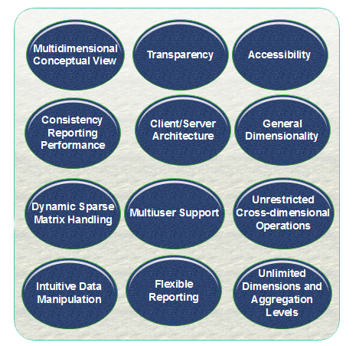
OLAP Guidelines

Slide 47
OLAP Guidelines
Multidimensional Conceptual View: This is the central features of an OLAP system. By needing a multidimensional view, it is possible to carry out methods like slice and dice.
Transparency: Make the technology, underlying information repository, computing operations, and the dissimilar nature of source data totally transparent to users. Such transparency helps to improve the efficiency and productivity of the users.
Accessibility: It provides access only to the data that is actually required to perform the particular analysis, present a single, coherent, and consistent view to the clients.

Slide 48
OLAP Guidelines
Consistent Reporting Performance: The performance of OLAP should not suffer as the number of dimensions is increased. Users must observe consistent run time, response time, or machine utilization every time a given query is run.
Client/Server Architecture: Make the server component of OLAP tools sufficiently intelligent that the various clients to be attached with a minimum of effort and integration programming. The server should be capable of mapping and consolidating data between dissimilar databases.
Generic Dimensionality: An OLAP method should treat each dimension as equivalent in both is structure and operational capabilities. Additional operational capabilities may be allowed to selected dimensions, but such additional tasks should be grantable to any dimension.

Slide 49
OLAP Guidelines
Dynamic Sparse Matrix Handling: To adapt the physical schema to the specific analytical model being created and loaded that optimizes sparse matrix handling
Multiuser Support: OLAP tools must provide concurrent data access, data integrity, and access security.
Unrestricted cross-dimensional Operations: It provides the ability for the methods to identify dimensional order and necessarily functions roll-up and drill-down methods within a dimension or across the dimension.

Slide 50
OLAP Guidelines
Intuitive Data Manipulation: Data Manipulation fundamental the consolidation direction like as reorientation (pivoting), drill-down and roll-up, and another manipulation. It avoids the use of a menu or multiple trips to a user interface.
Flexible Reporting: It implements efficiency to the business clients to organize columns, rows, and cells in a manner that facilitates simple manipulation, analysis, and synthesis of data.
Unlimited Dimensions and Aggregation Levels: The number of data dimensions should be unlimited. Each of these common dimensions must allow a practically unlimited number of customer-defined aggregation levels within any given consolidation path.

Slide 51
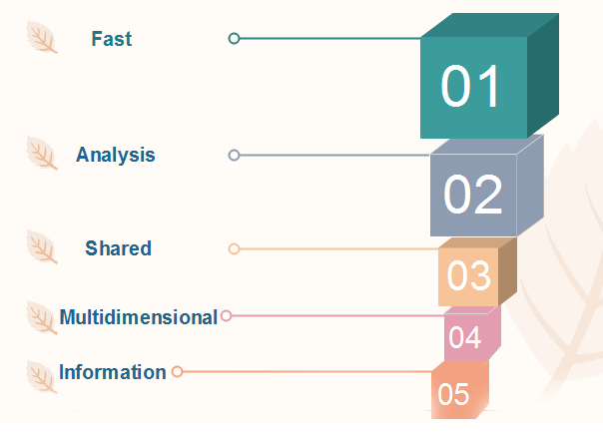
Characteristics of OLAP

Slide 52
Motivations for using OLAP
Understanding and improving sales
Understanding and decreasing costs of doing business

Slide 53
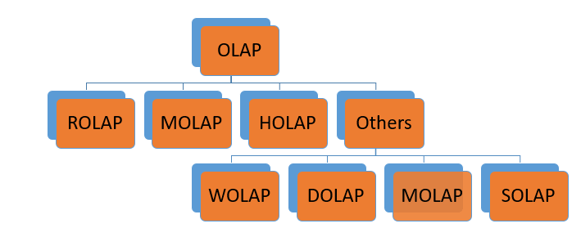
Types of OLAP Servers
Relational OLAP (ROLAP)
Multidimensional OLAP (MOLAP)
Hybrid OLAP (HOLAP)

Slide 54
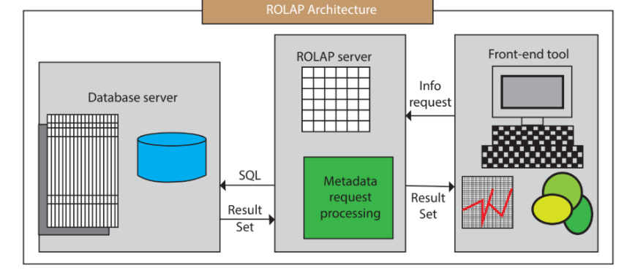
Relational OLAP (ROLAP)
ROLAP Architecture includes the following components
Database server.
ROLAP server.
Front-end tool.

Slide 55
Relational OLAP (ROLAP)
These are intermediate servers which stand in between a relational back-end server and user frontend tools.
They use a relational or extended-relational DBMS to save and handle warehouse data, and OLAP middleware to provide missing pieces.
ROLAP servers contain optimization for each DBMS back end, implementation of aggregation navigation logic, and additional tools and services.
ROLAP technology tends to have higher scalability than MOLAP technology.
ROLAP systems work primarily from the data that resides in a relational database, where the base data and dimension tables are stored as relational tables. This model permits the multidimensional analysis of data.

Slide 56
Advantages
Can handle large amounts of information:
The data size limitation of ROLAP technology is depends on the data size of the underlying RDBMS. So, ROLAP itself does not restrict the data amount.

Slide 57
Disadvantages
Performance can be slow: Each ROLAP report is a SQL query (or multiple SQL queries) in the relational database, the query time can be prolonged if the underlying data size is large.
Limited by SQL functionalities: ROLAP technology relies on upon developing SQL statements to query the relational database, and SQL statements do not suit all needs

Slide 58
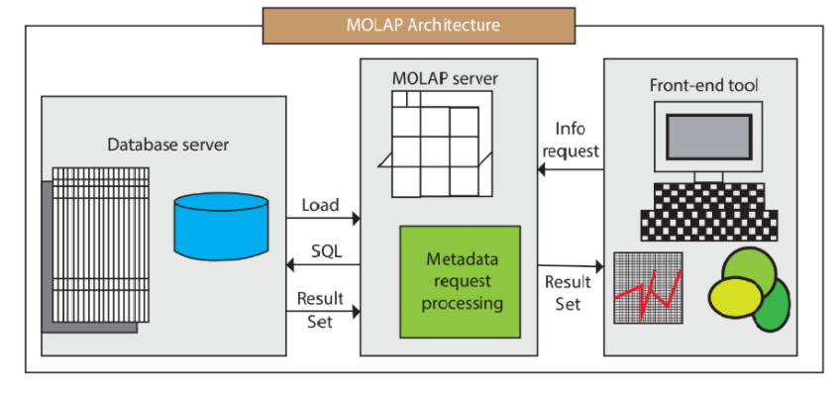
Multidimensional OLAP (MOLAP) Server
MOLAP Architecture includes the following components
Database server.
MOLAP server.
Front-end tool.

Slide 59
Multidimensional OLAP (MOLAP) Server
A MOLAP system is based on a native logical model that directly supports multidimensional data and operations. Data are stored physically into multidimensional arrays, and positional techniques are used to access them.
One of the significant distinctions of MOLAP against a ROLAP is that data are summarized and are stored in an optimized format in a multidimensional cube, instead of in a relational database.
In MOLAP model, data are structured into proprietary formats by client's reporting requirements with the calculations pre-generated on the cubes.

Slide 60
Advantages
MOLAP allows fastest indexing to the pre-computed summarized data.
Helps the users connected to a network who need to analyze larger, less-defined data.
Easier to use, therefore MOLAP is suitable for inexperienced users

Slide 61
Disadvantages
MOLAP are not capable of containing detailed data.
The storage utilization may be low if the data set is sparse.

Slide 62
MOLAP vs ROLAP
Sr.No. | MOLAP | ROLAP
1 | Information retrieval is fast. | Information retrieval is comparatively slow.
2 | Uses sparse array to store data-sets. | Uses relational table.
3 | MOLAP is best suited for inexperienced users, since it is very easy to use. | ROLAP is best suited for experienced users.
4 | Maintains a separate database for data cubes. | It may not require space other than available in the Data warehouse.
5 | DBMS facility is weak. | DBMS facility is strong.

Slide 63
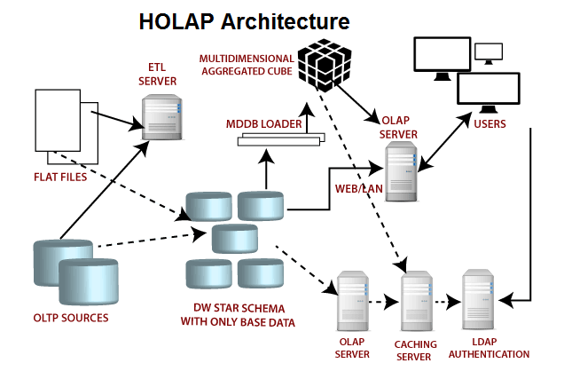
Hybrid OLAP (HOLAP) Server
HOLAP incorporates the best features of MOLAP and ROLAP into a single architecture.
HOLAP systems save more substantial quantities of detailed data in the relational tables while the aggregations are stored in the pre-calculated cubes.

Slide 64
Advantages
HOLAP provide benefits of both MOLAP and ROLAP.
It provides fast access at all levels of aggregation.
HOLAP balances the disk space requirement, as it only stores the aggregate information on the OLAP server and the detail record remains in the relational database. So no duplicate copy of the detail record is maintained.

Slide 65
Disadvantages
HOLAP architecture is very complicated because it supports both MOLAP and ROLAP servers.

Slide 66
Other types
Web-Enabled OLAP (WOLAP) Server
WOLAP pertains to OLAP application which is accessible via the web browser. Unlike traditional client/server OLAP applications, WOLAP is considered to have a three-tiered architecture which consists of three components: a client, a middleware, and a database server.
Desktop OLAP (DOLAP) Server
DOLAP permits a user to download a section of the data from the database or source, and work with that dataset locally, or on their desktop.
Mobile OLAP (MOLAP) Server
Mobile OLAP enables users to access and work on OLAP data and applications remotely through the use of their mobile devices.
Spatial OLAP (SOLAP) Server
SOLAP includes the capabilities of both Geographic Information Systems (GIS) and OLAP into a single user interface. It facilitates the management of both spatial and non-spatial data.

Slide 67
Multidimensional versus Multi relational OLAP
Sl.No | Multi relational OLAP | Multidimensional OLAP
1 | Relational models can be very complex with hundreds of tables having long chains of relationship among them | Multidimensional modeling are very simple. Each of the dimension table has a direct relationship with the facttable
2 | Normal data modeling is quite flexible. | The Multidimensional modeling has a rigid structure
3 | the goals of relational modeling is to confirm to the rules of normalization | Multidimensional modeling are radically denormalized. The dimension tables have a high number of repeated values in their fields
4 | Standard relational models are optimized for On Line Transaction Processing. | Multidimensional modeling are optimized for On Line Analytical Processing. OLAP needs the ability to retrieve data efficiently.

Slide 68
Multidimensional versus Multi relational OLAP
Sl.No | Multi relational OLAP | Multidimensional OLAP
5 | Tables are units of relational data storage. | Cubes are units of multi-dimensional data storage.
6 | Table fields of particular data type store the actual data | Dimensions and measures stores actual data.
7 | Table size is measured in number of record set. | Cube size is measured in number of Cellsets

Slide 69
Difference between OLAP and OLTP
Operational Database | Data Warehouse
Operational systems are designed to support high-volume transaction processing. | Data warehousing systems are typically designed to support high-volume analytical processing (i.e., OLAP).
Operational systems are usually concerned with current data. | Data warehousing systems are usually concerned with historical data.
Data within operational systems are mainly updated regularly according to need. | Non-volatile, new data may be added regularly. Once Added rarely changed.
It is designed for real-time business dealing and processes. | It is designed for analysis of business measures by subject area, categories, and attributes.
Operational systems are widely process-oriented. | Data warehousing systems are widely subject-oriented

Slide 70
Difference between Operational Database and Data Warehouse
Operational Database | Data Warehouse
Operational systems are usually optimized to perform fast inserts and updates of associatively small volumes of data. | Data warehousing systems are usually optimized to perform fast retrievals of relatively high volumes of data.
Less Number of data accessed. | Large Number of data accessed.
Relational databases are created for on-line transactional Processing (OLTP) | Data Warehouse designed for on-line Analytical Processing (OLAP)

Slide 71
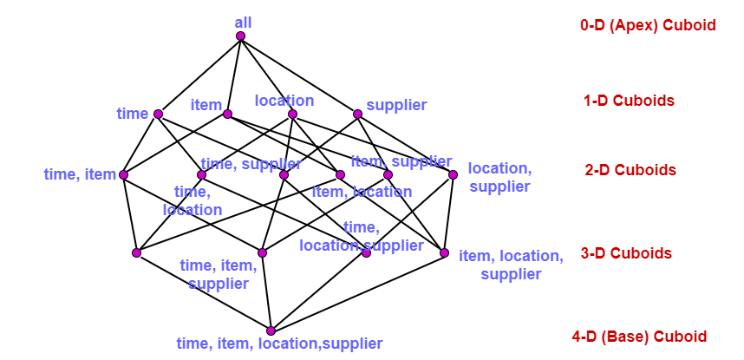
Data Cube
When data is grouped or combined in multidimensional matrices called Data Cubes.
Other names of Data Cube are "Multidimensional databases," "materialized views," and "OL”AP

Slide 72
Example
Suppose that a data warehouse consists of the three dimensions time, doctor, and patient, and the two measures count and charge, where charge is the fee that a doctor charges a patient for a visit.
(a) Enumerate three classes of schemas that are popularly used for modeling data warehouses with neat diagram.
(b) Draw a schema diagram for the above data warehouse using one of the schema classes listed in (a).
(c) Starting with the base cuboid [day, doctor, patient], what specific OLAP operations should be performed in order to list the total fee collected by each doctor in 2010?
(d) To obtain the same list, write an SQL query assuming the data is stored in a relational database with the schema fee (day, month, year, doctor, hospital, patient, count, charge).

Slide 73
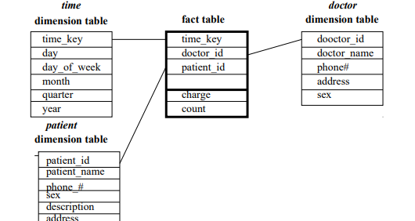
a.Three classes of schemas popularly used for modeling data warehouses are the star schema, the snowflake schema, and the fact constellation schema.
A star schema is shown in Figure

Slide 74
(c) The operations to be performed are:
• Roll-up on time from day to year.
• Slice for time = 2010.
• Roll-up on patient from individual patient to all.
d) select doctor, SUM(charge) from fee where year = 2010 group by doctor

Slide 75
Suppose that a base cuboid has three dimensions, A, B, C, with the following number of cells: |A| = 1, 000, 000, |B| = 100, and |C| = 1000. Suppose that each dimension is evenly partitioned into 10 portions for chunking.
(a) Assuming each dimension has only one level, draw the complete lattice of the cube.
(b) If each cube cell stores one measure with 4 bytes, what is the total size of the computed cube if the cube is dense?
(c) State the order for computing the chunks in the cube that requires the least amount of space, and compute the total amount of main memory space required for computing the 2-D planes.

Slide 76
all - apex
A b c - 1D
Ab bc ac - 2d
Abc - base cuboid

Slide 77
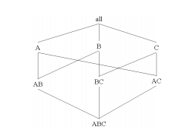
A).

Slide 78
all: 1
• A: 1,000,000; B: 100; C: 1, 000; subtotal: 1,001,100
AB: 100,000,000; BC: 100,000; AC: 1,000,000,000; subtotal: 1,100,100,000
• ABC:100,000,000,000
• Total: 101,101,101,101 cells × 4 bytes = 404,404,404,404 bytes

Slide 79
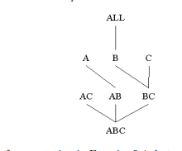
The total amount of main memory space required for computing the 2-D planes is: Total space = (100 × 1,000) (for the whole BC plane) + (1,000,000 × 10) (for one column of the AB plane) + (100 × 100,000) (for one chunk of the AC plane) = 20,100,000 cells = 80,400,000 bytes.

Slide 80
Suppose departmental store has implemented data warehouse. If dimensions of a data cube in the implemented data warehouse are Product, Date, and Store, and the measure attribute is Sales. Assume that for all stores sales information is available for almost all dates, and every store sells its own selection of brands. Identify sparse the dimensions, and propose a suitable physical organization for the data cube.
Enumerate all schema diagrams for the above data warehouse. For each dimension, include the appropriate attributes
Draw the lattice of cuboids (from apex to base cuboid) for the above data warehouse.
Starting with the base cuboid, what specific OLAP operations (roll-up, drill down, dice, slice) should be performed (based on your schema) in order to calculate the unit sold in each location in the year 2018?
Assume that each dimension has four levels. How many cuboids will this cube contain?

Slide 81
Schema Definition
Multidimensional schema is defined using Data Mining Query Language (DMQL).
Syntax for Cube Definition
Syntax for Dimension Definition
define dimension < dimension_name > as ( < attribute_or_dimension_list > )
define cube < cube_name > [ < dimension-list > }: < measure_list >

Slide 82
Star Schema definition in DMQL
Construct Star Schema definition in DMQL for the college data with respect to the three dimensions, namely , student, department and courses. The fact table also contains the attributes, namely grade and average.

Slide 83
Snow Flake Schema definition in DMQL
construct Snow flake Schema definition in DMQL for the five dimensions, date, spectator, location, and game, and the two measures, count and charge, where charge is the fare that a spectator pays when watching a game on a given date. Spectators may be students, adults, or seniors, with each category having its own charge rate. The location dimension is further divided to City dimension table . Identify the schema and draw the diagram.

Slide 84
Fact Constellation definition in DMQL
Construct Fact Constellation definition in DMQL sales data warehouse consists two fact tables, one, sales fact and other ship fact. Both fact shares the product and date dimension tables. As you can see centralized fact tables holds the primary key from the dimension tables. The sales data of a company with respect to the four dimensions, namely time, item, branch, and location. The shipping fact table has the five dimensions, namely item_key, time_key, shipper_key, from_location, to_location.

Slide 85
define cube sales [time, item, branch, location]:
dollars sold = sum(sales in dollars), units sold = count(*)
define dimension time as (time key, day, day of week, month, quarter, year)
define dimension item as (item key, item name, brand, type, supplier type)
define dimension branch as (branch key, branch name, branch type)
define dimension location as (location key, street, city, province or state,country)
define cube shipping [time, item, shipper, from location, to location]:
dollars cost = sum(cost in dollars), units shipped = count(*)
define dimension time as time in cube sales
define dimension item as item in cube sales

Slide 86
Suppose that a data warehouse for Big-University consists of the following four dimensions: student, course, semester, and instructor, and two measures count and avg_grade. When at the lowest conceptual level (e.g., for a given student, course, semester, and instructor combination), the avg_grade measure stores the actual course grade of the student. At higher conceptual levels, avg_grade stores the average grade for the given combination.
Draw a snowflake schema diagram for the data warehouse.
Starting with the base cuboid [student, course, semester, instructor], what specific OLAP operations (e.g., roll-up from semester to year) should one perform in order to list the average grade of CS courses for each Big-University student.
If each dimension has five levels (including all), such as student < major < status < university < all, how many cuboids will this cube contain (including the base and apex cuboids)?

Slide 87
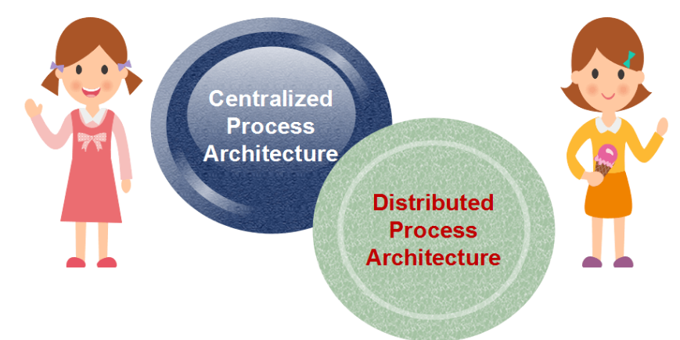
Data Warehouse Process Architecture
The process architecture defines an architecture in which the data from the data warehouse is processed for a particular computation.

Slide 88
Centralized Process Architecture
Centralized process architecture evolved with transaction processing and is well suited for small organizations with one location of service.
It requires minimal resources both from people and system perspectives.
It is very successful when the collection and consumption of data occur at the same location.

Slide 89
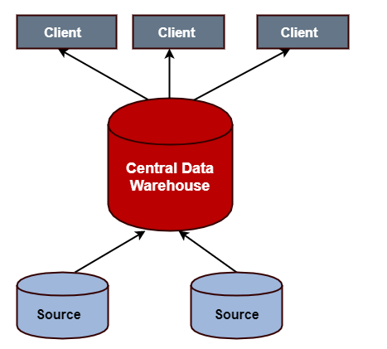
Centralized Process Architecture

Slide 90
Distributed Process Architecture
information and its processing are allocated across data centers, and its processing is distributed across data centers, and processing of data is localized with the group of the results into centralized storage.
Types of
Client-Server
Three-tier Architecture
N-tier Architecture
Cluster Architecture
Peer-to-Peer Architecture

Slide 91
References
.https://www.javatpoint.com/data-warehouse-components
PPT of text books

